Slide 1


Euroscepticism Revisited
HOW UNCERTAINTY, SOCIAL COHESION,
AND INSECURITY SHAPE PUBLIC OPINION AND
POPULIST PARTY SUCCESS
Matthew Hansen Wetsel II

Slide 2
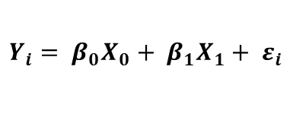
Presentation Overview
$$Y_{i}= β_{0}X_{0}+ β_{1}X_{1}+ ε_{i}$$
        Context
        Theory
        Research Design
        Preliminary Results
      TBD
      TBD
      TBD
      TBD
Track 4: Elections, Opposition, and Political Contestation
IPSA Regional Conference 2026
1

Slide 3
Context
      RQ: Why are some Eurosceptic parties more successful than others?
            Supply & Demand
            Exogenous Shocks
            Institutional Path Dependencies

Slide 4
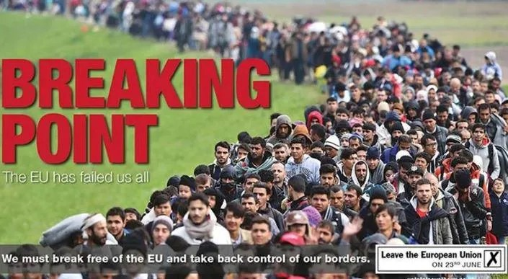
Theory
      Material
            Proxy Benchmarking
            Social Capital Hypothesis
            Geographic Inequality
      Ideational
            Political Identity
            Cultural Backlash
            Affective Polarization

Slide 5
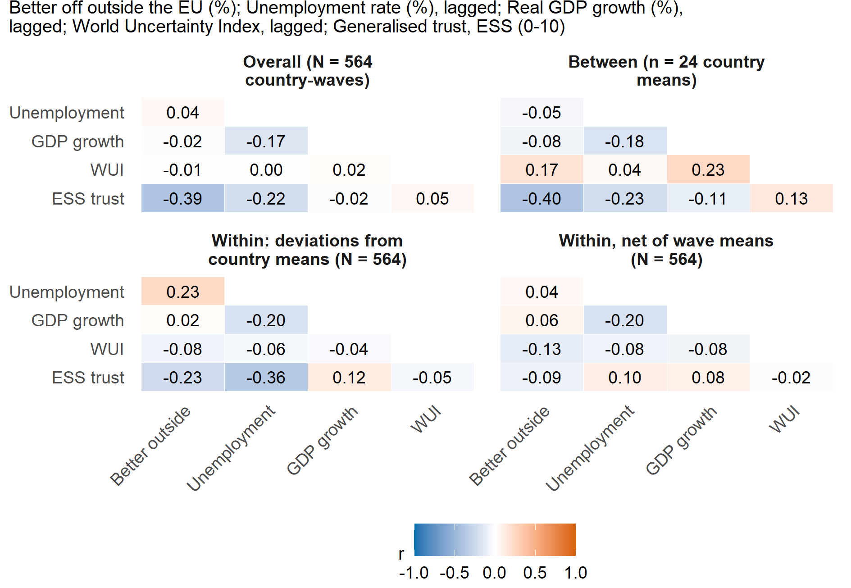
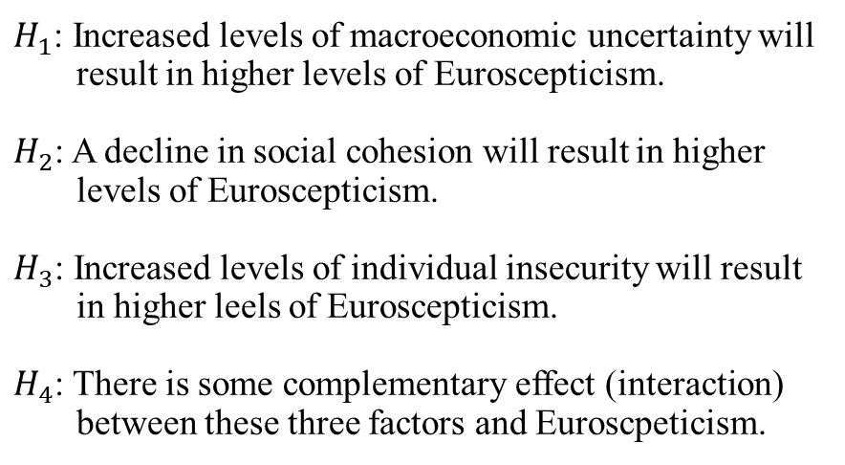
Research Design
      $H_{1}$: Increased levels of macroeconomic uncertainty will result in higher levels of Euroscepticism.
      $H_{2}$: A decline in social cohesion will result in higher levels of Euroscepticism.
      $H_{3}$: Increased levels of individual insecurity will result in higher leels of Euroscepticism.
      $H_{4}$: There is some complementary effect (interaction) between these three factors and Euroscpeticism.

Slide 6
Data
      Leibniz Institute for the Social Sciences
            https://www.gesis.org/en/eurobarometer-data-service
      The European Social Survey (ESS)
            https://ess.sikt.no/en
      The World Uncertainty Index
            https://worlduncertaintyindex.com/data/
      Global Macro Database (GMD)
            https://www.globalmacrodata.com/
      Eurostat
            https://ec.europa.eu/eurostat/data

Slide 7
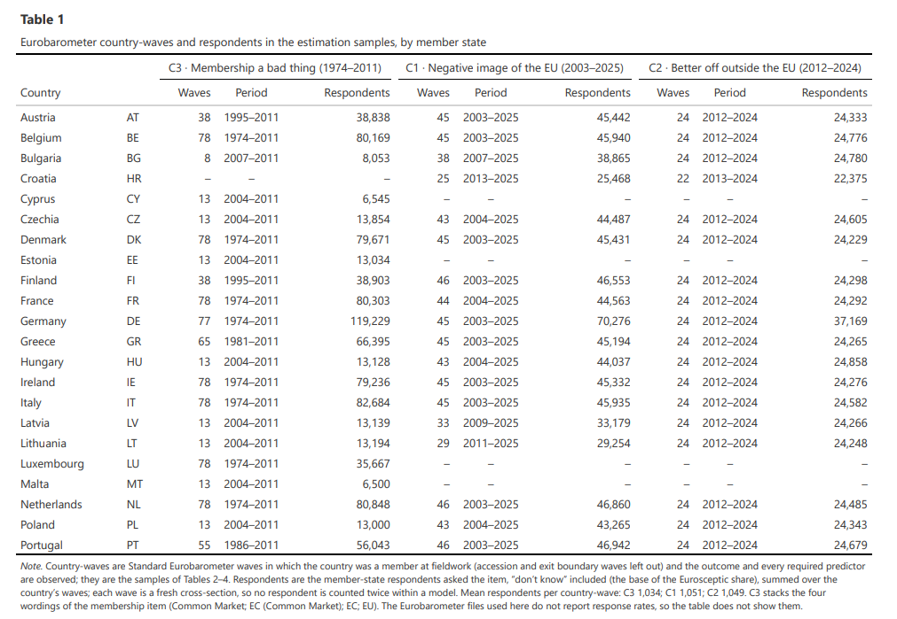

Slide 8
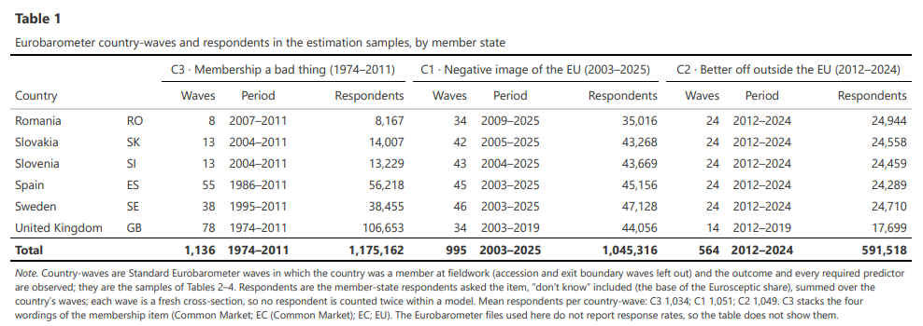

Slide 9
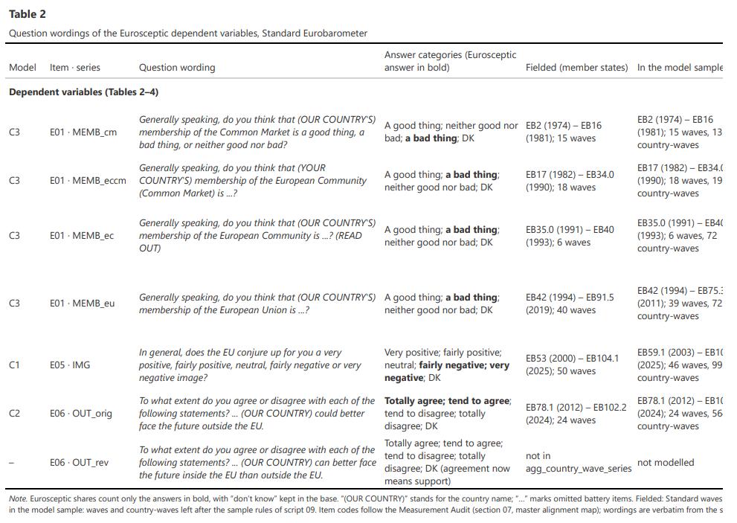

Slide 10
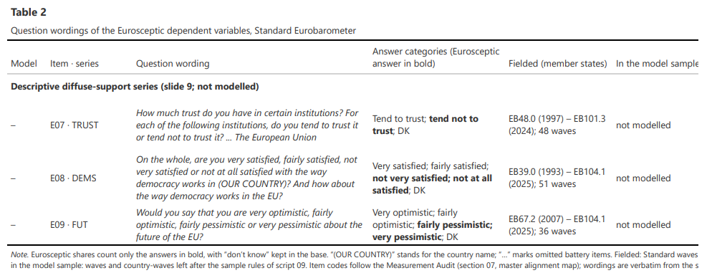

Slide 11
Preliminary Findings (1)

Slide 12
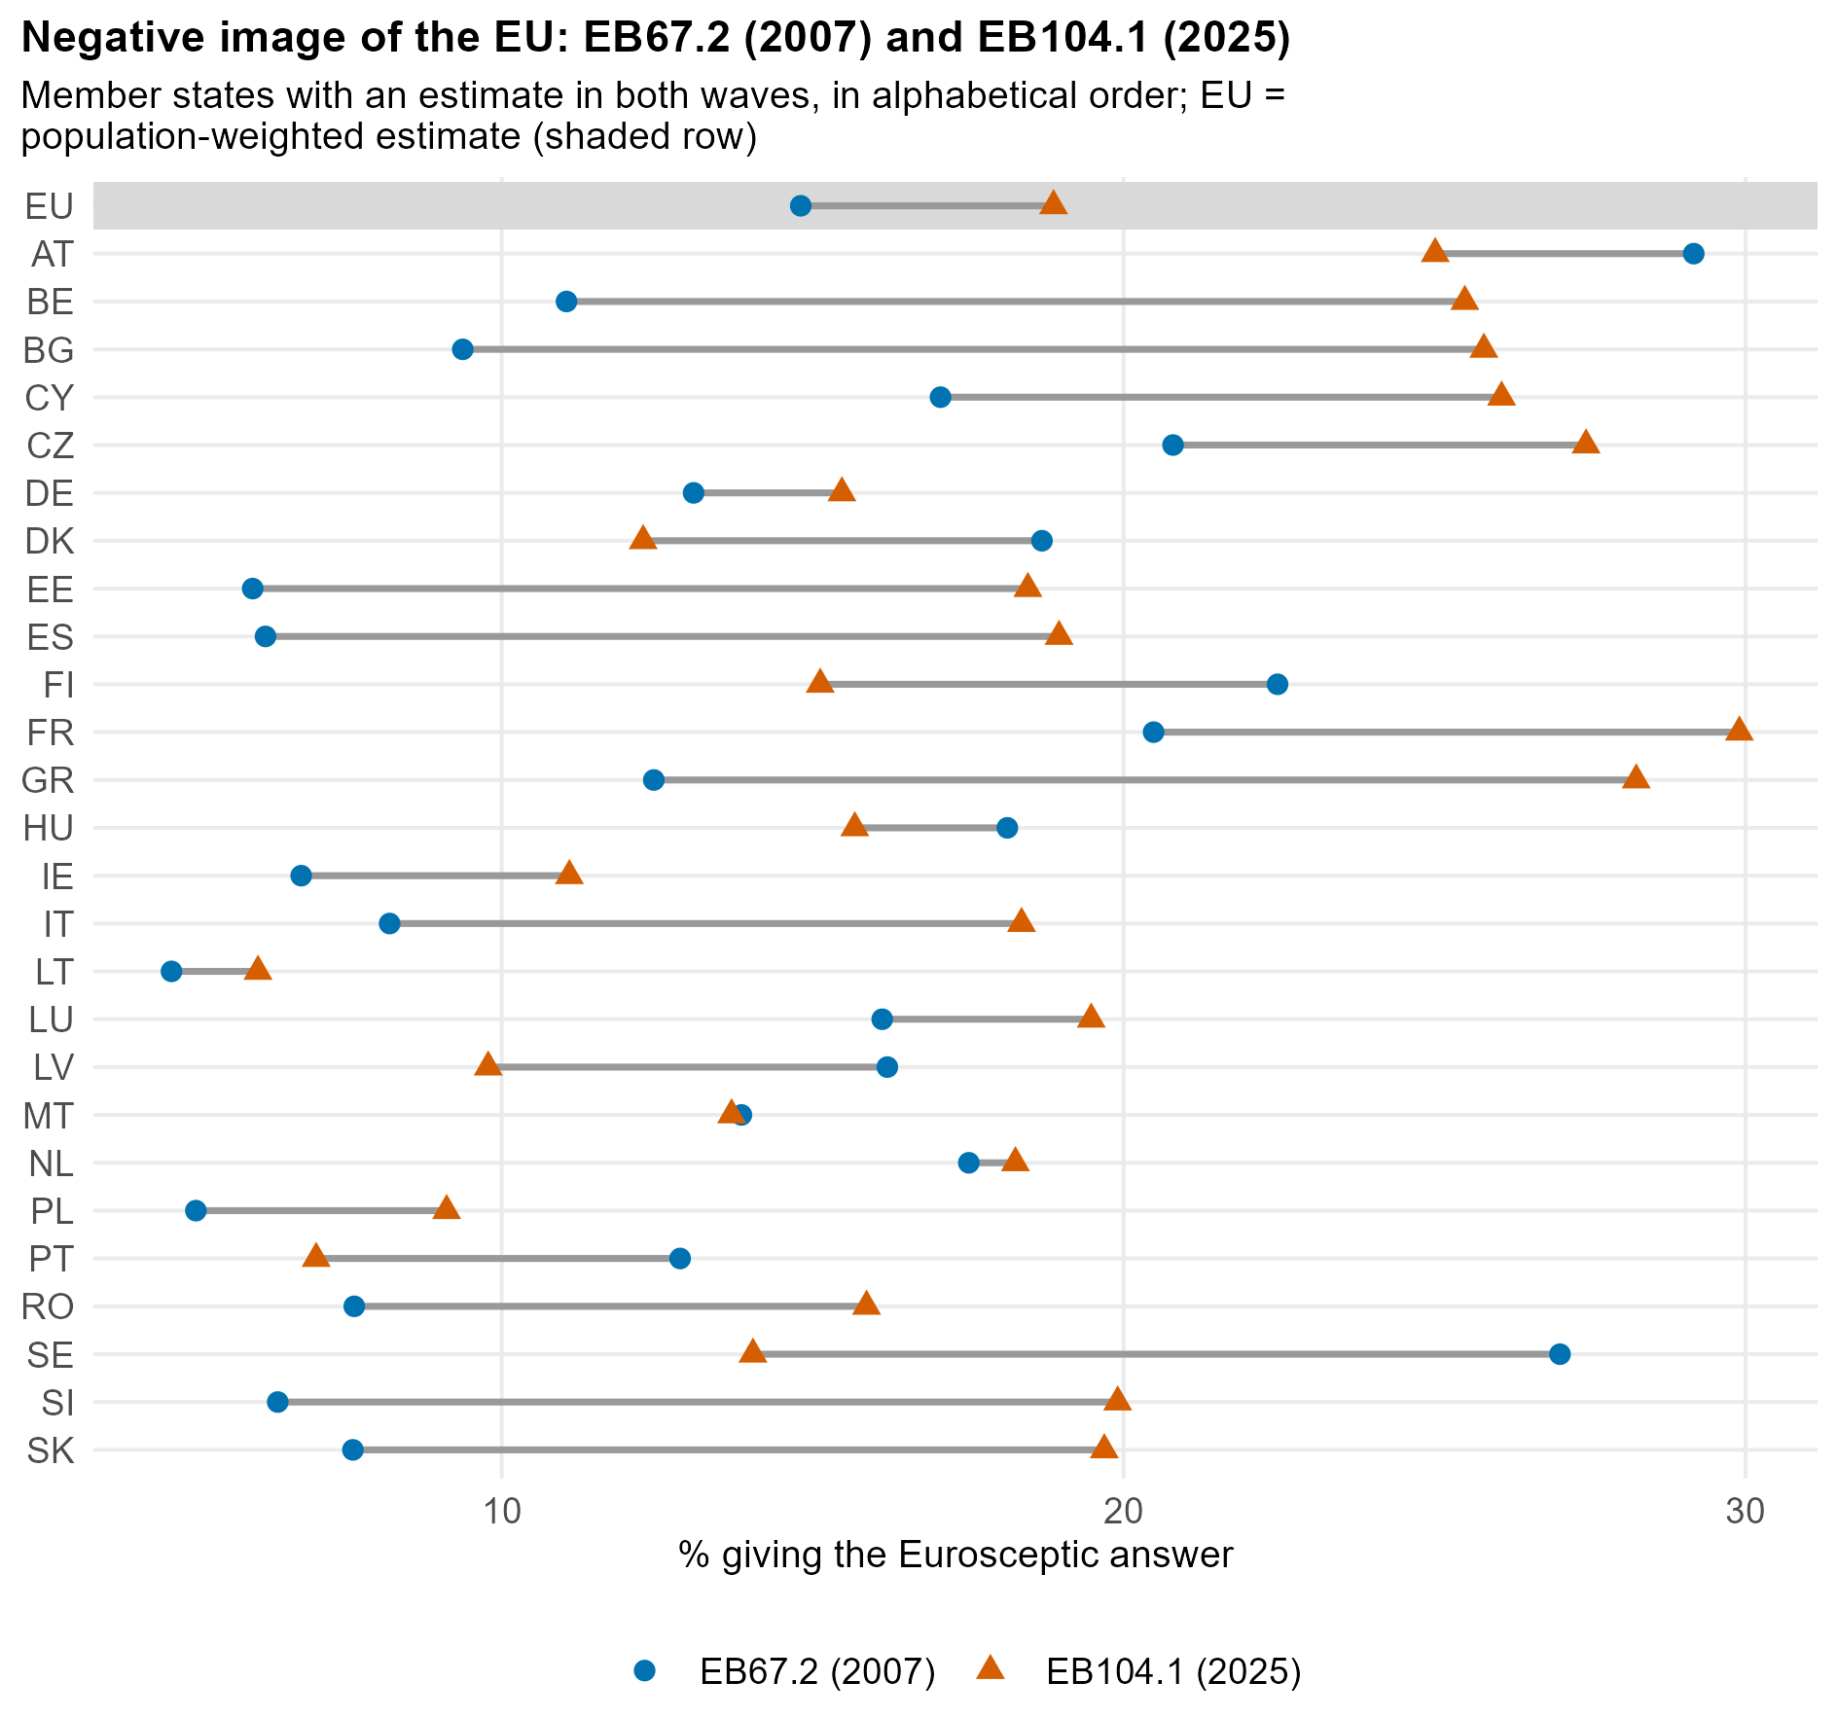

Slide 13
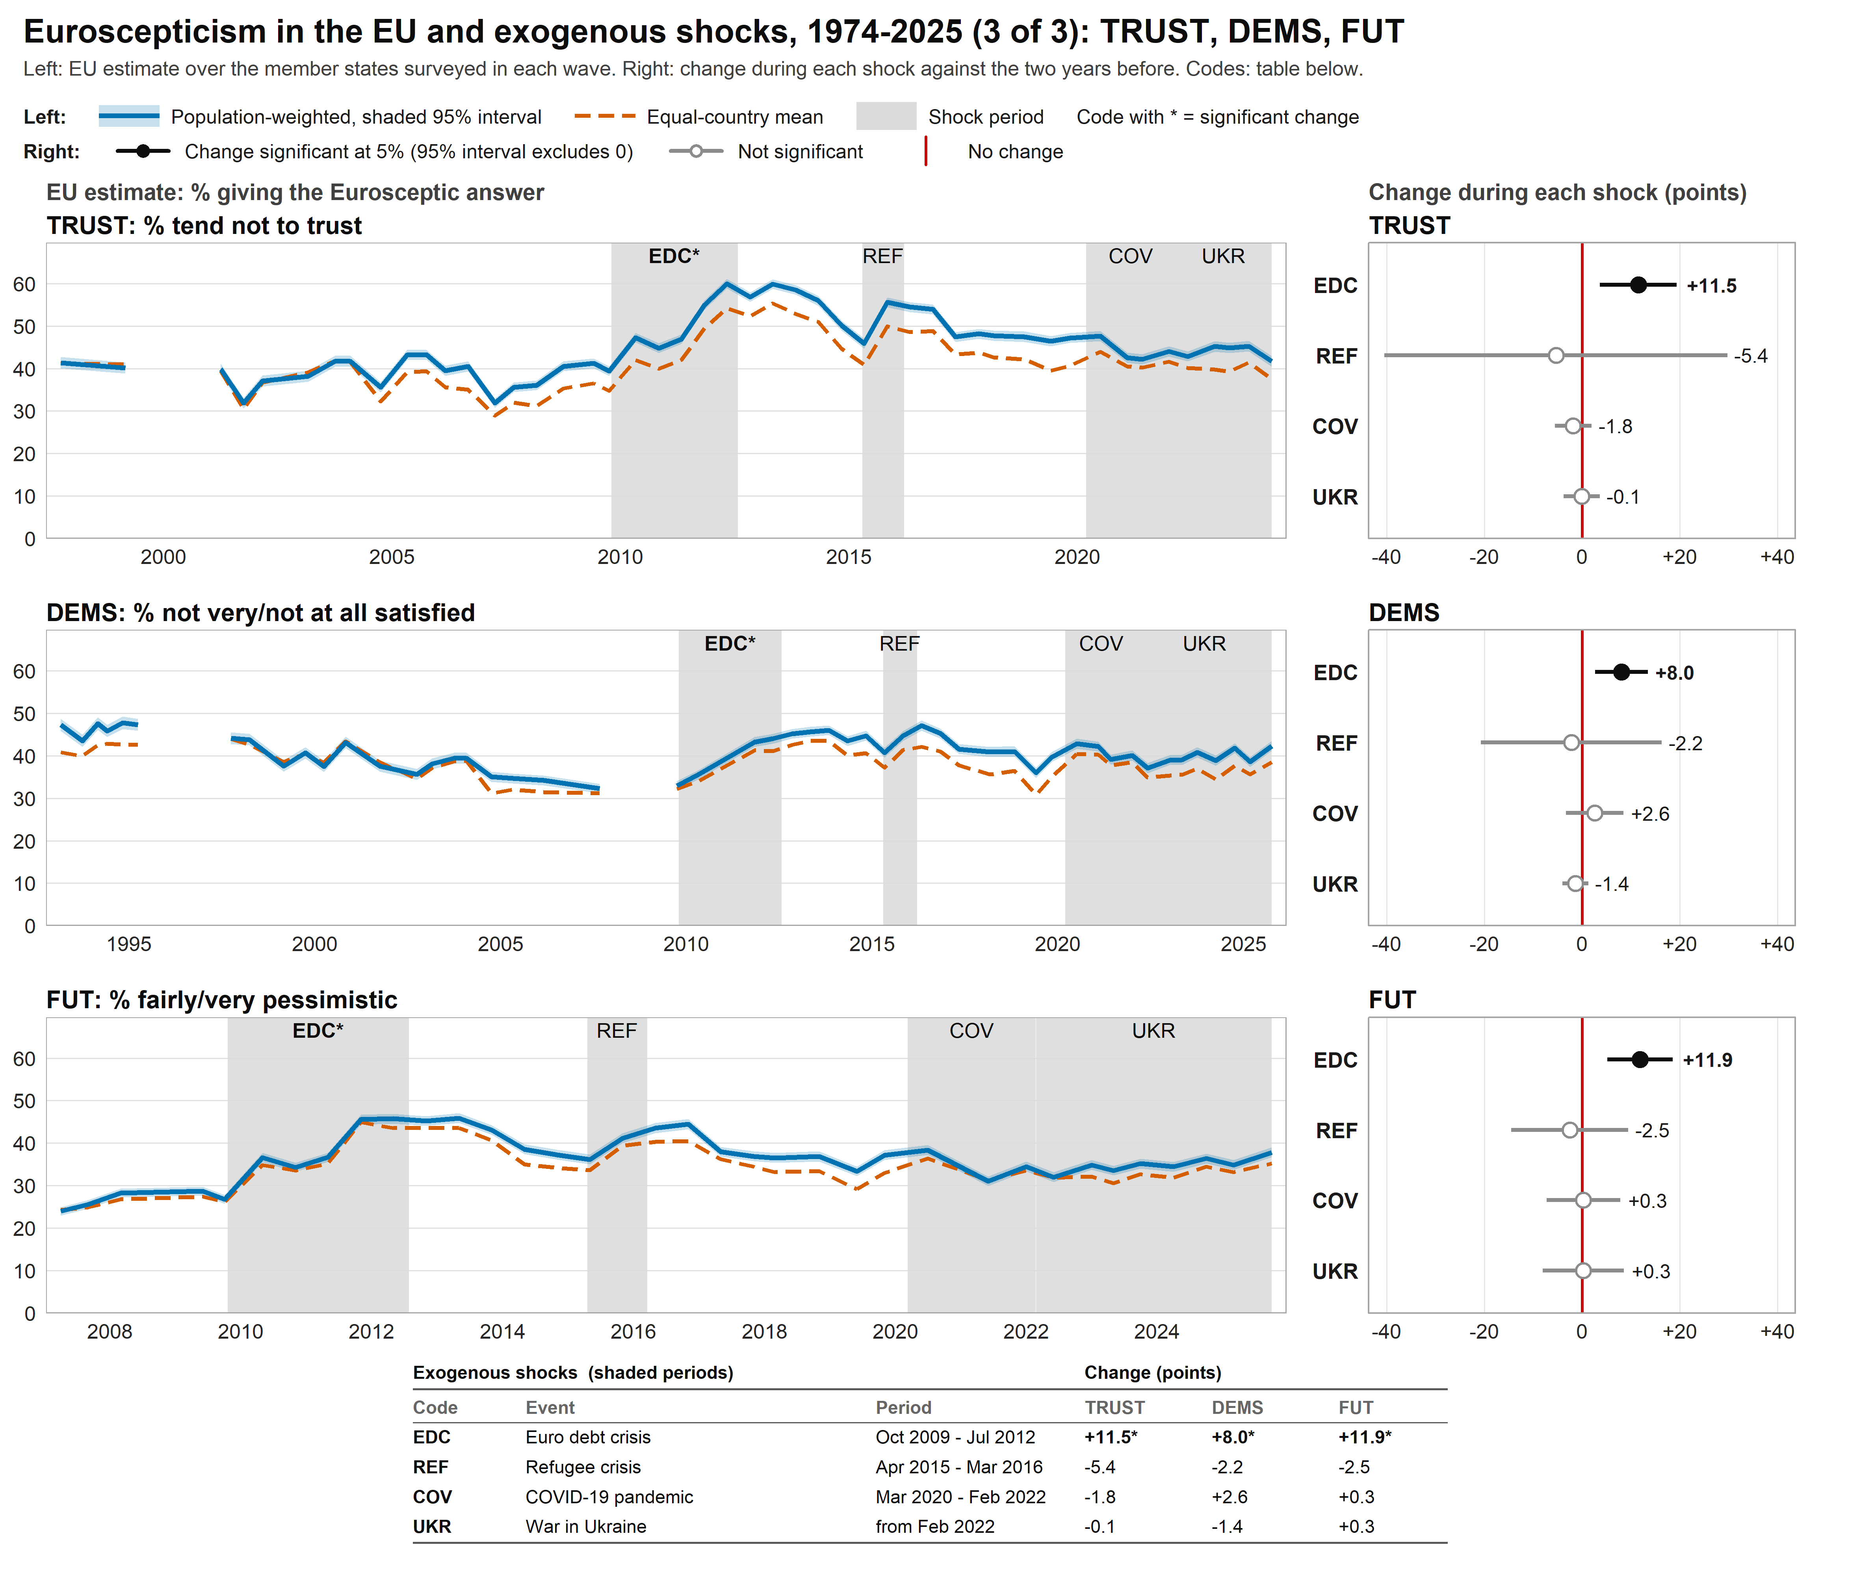

Slide 14
Preliminary Findings (2)

Slide 15
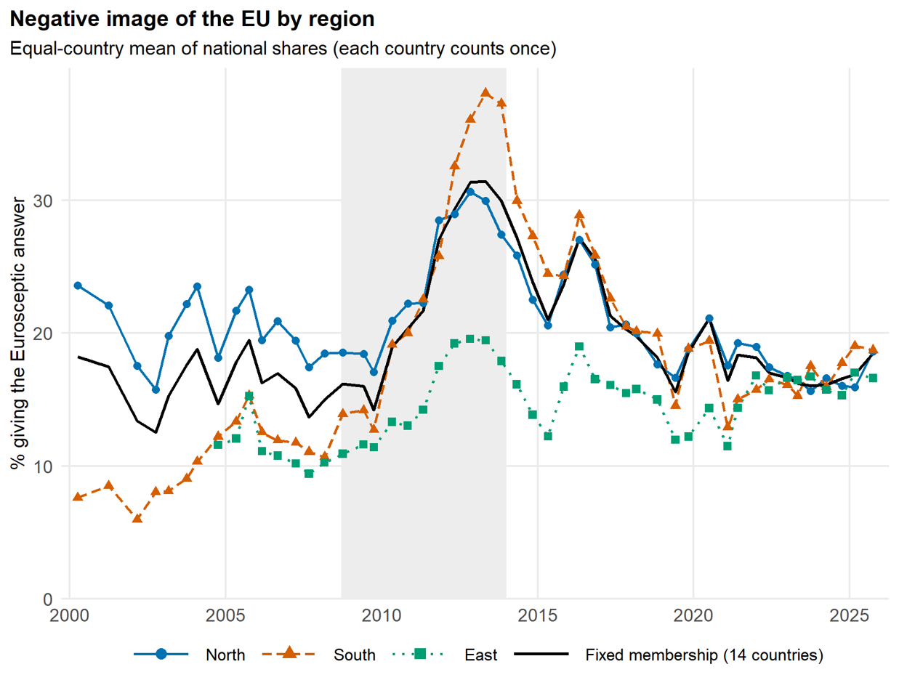

Slide 16
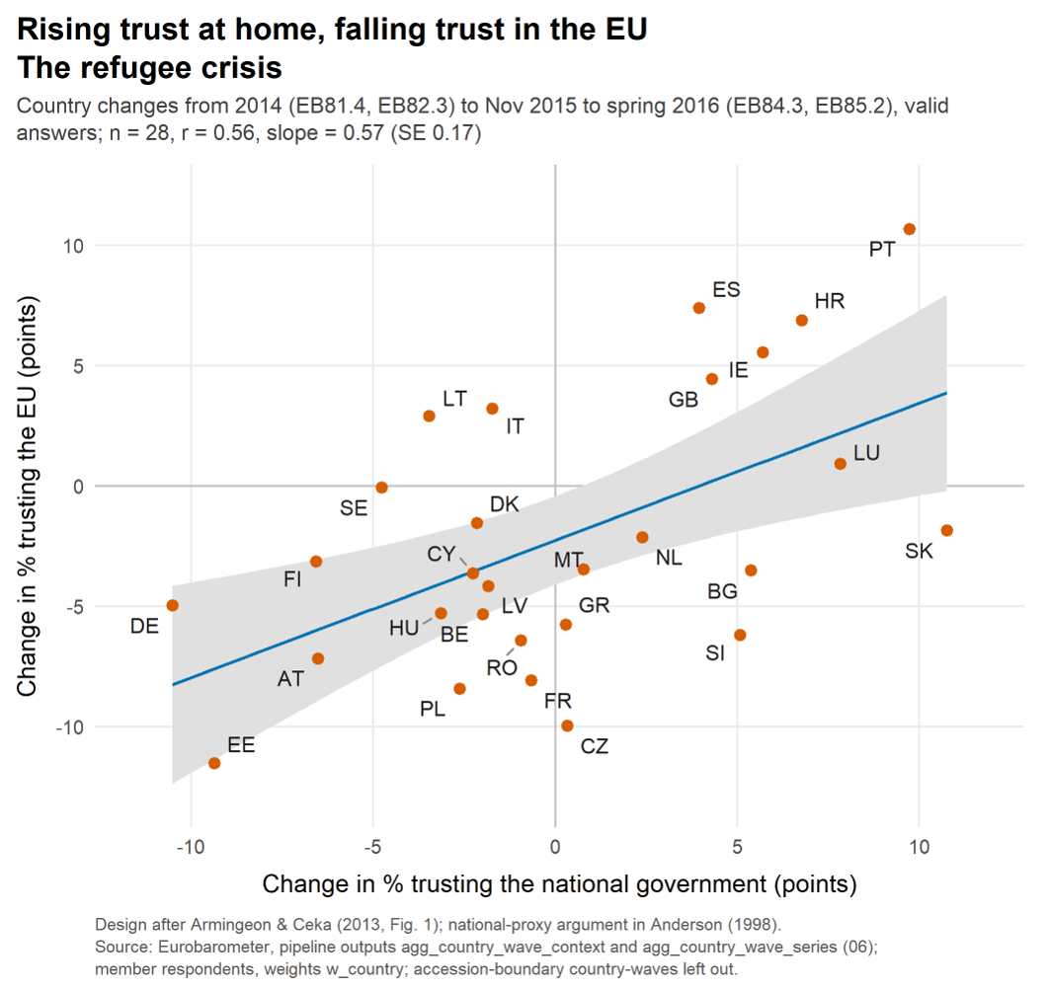
?

Slide 17
Statistical Analysis (1)

Slide 18
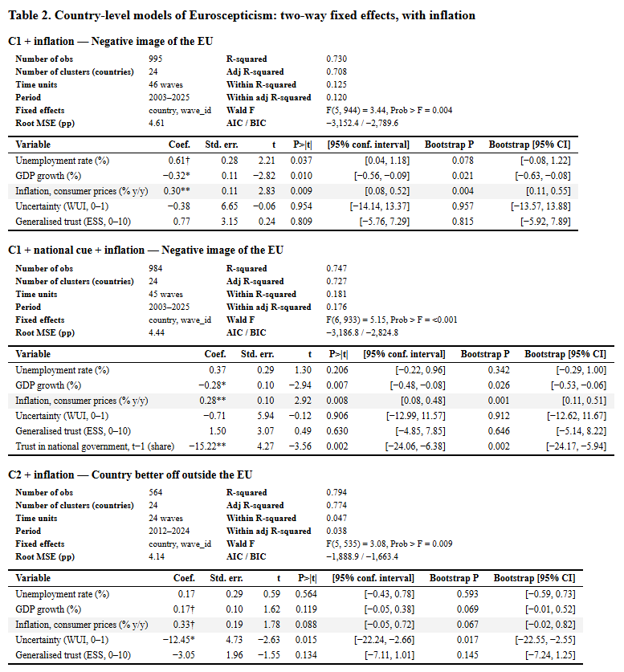

Slide 19
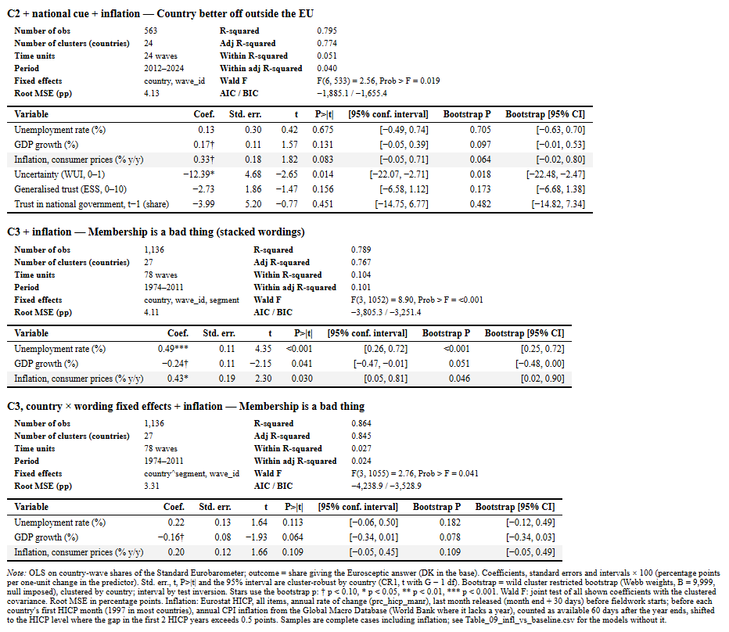

Slide 20
Statistical Analysis (2)

Slide 21
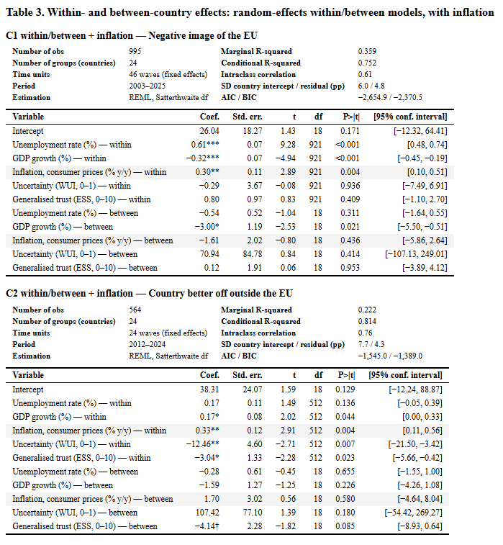

Slide 22
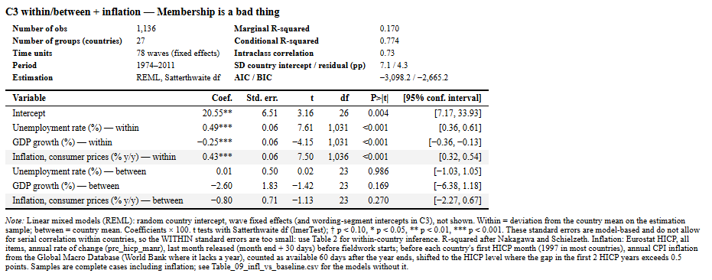

Slide 23
Statistical Analysis (3)

Slide 24
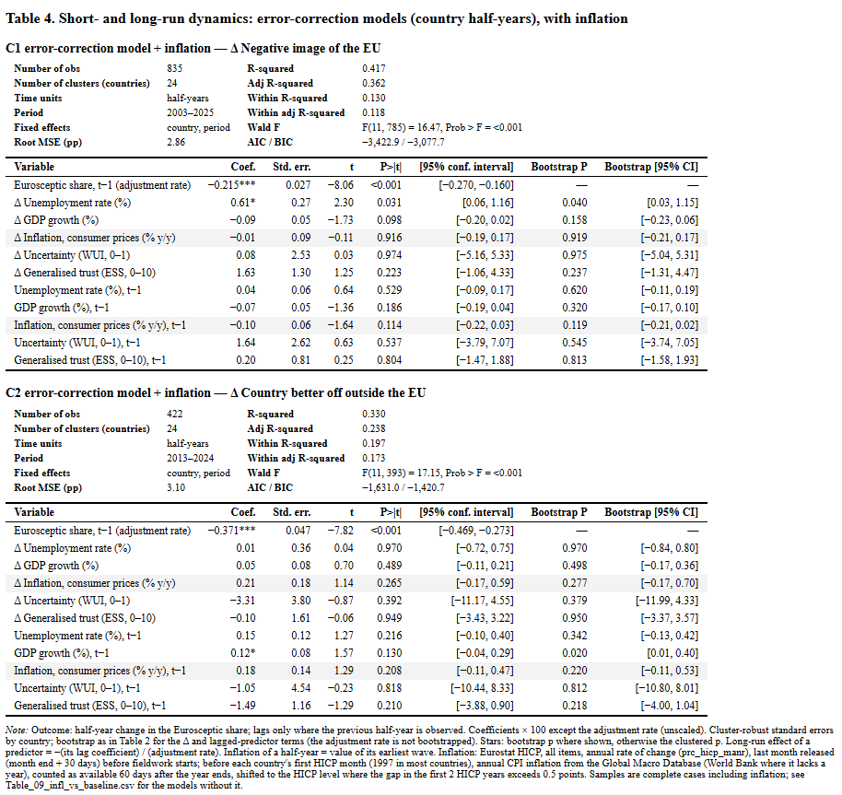

Slide 25
Data Visualization

Slide 26
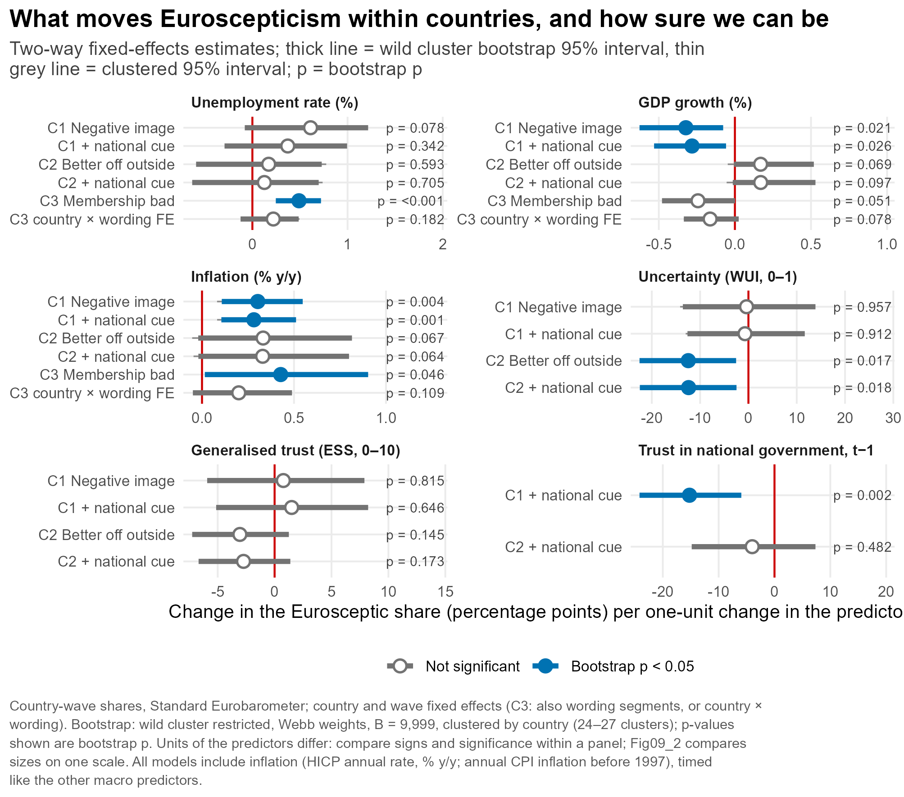

Slide 27
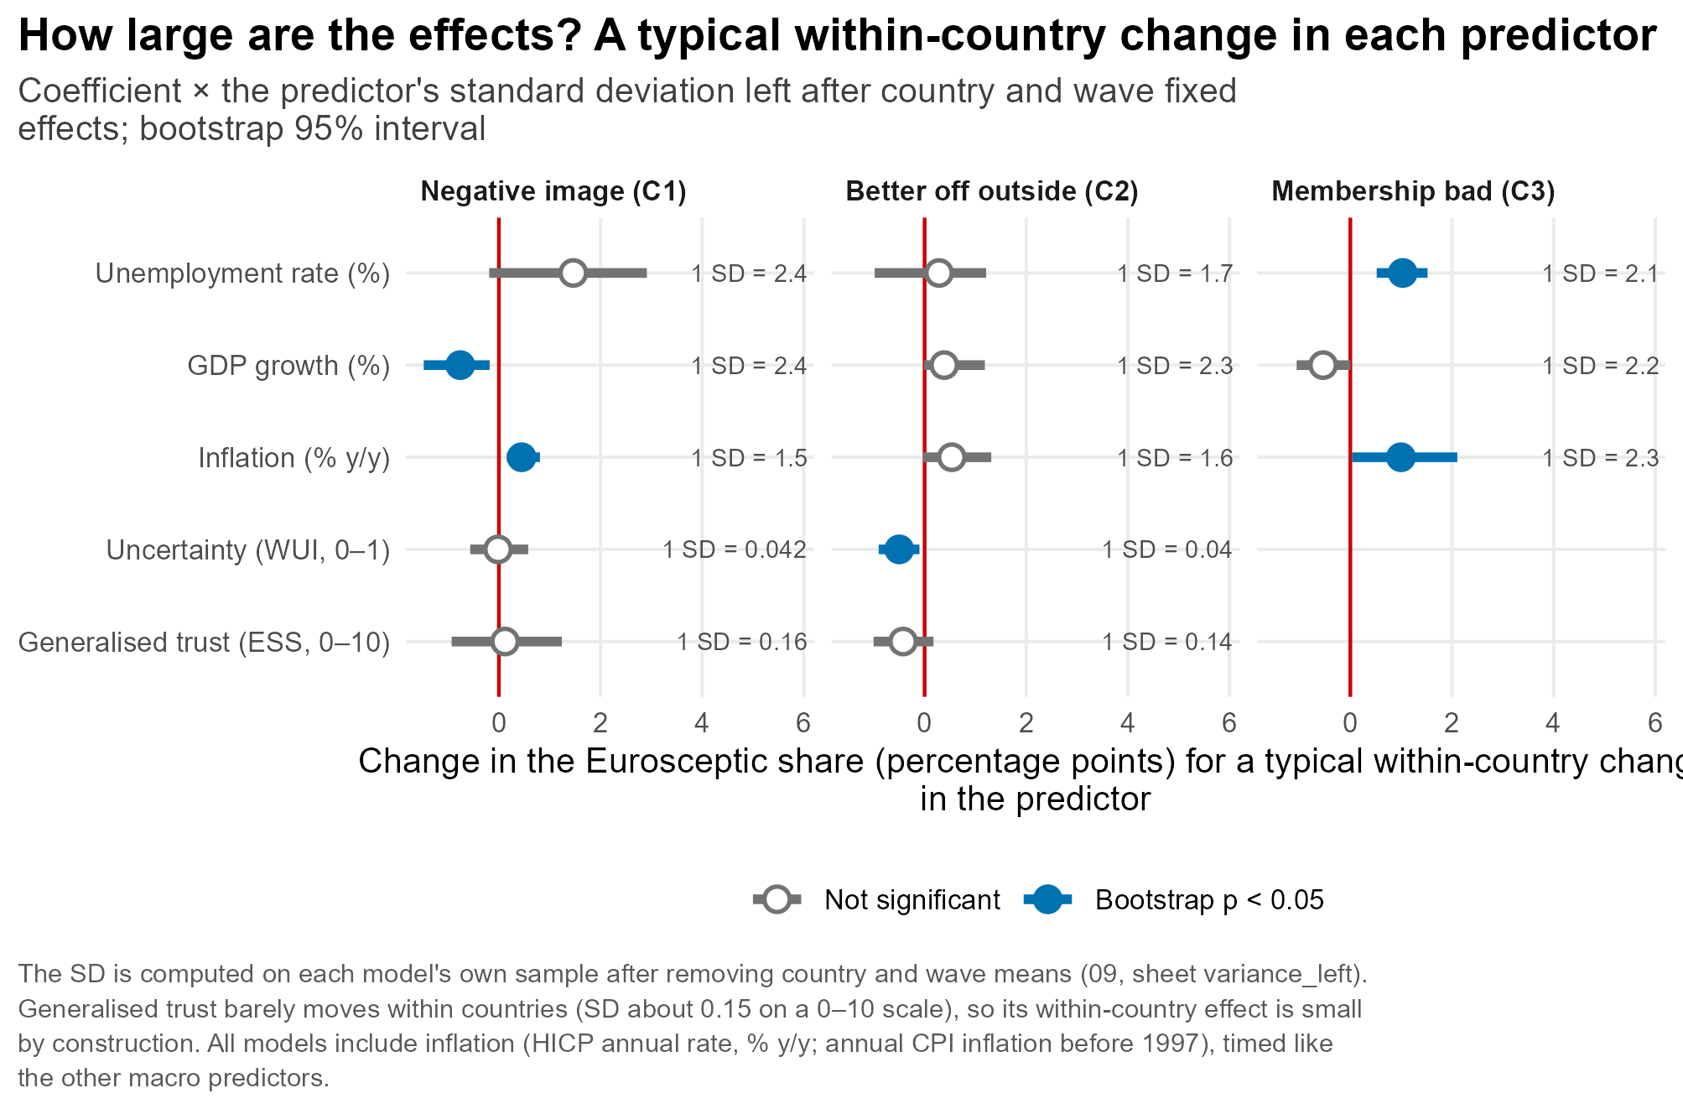

Slide 28
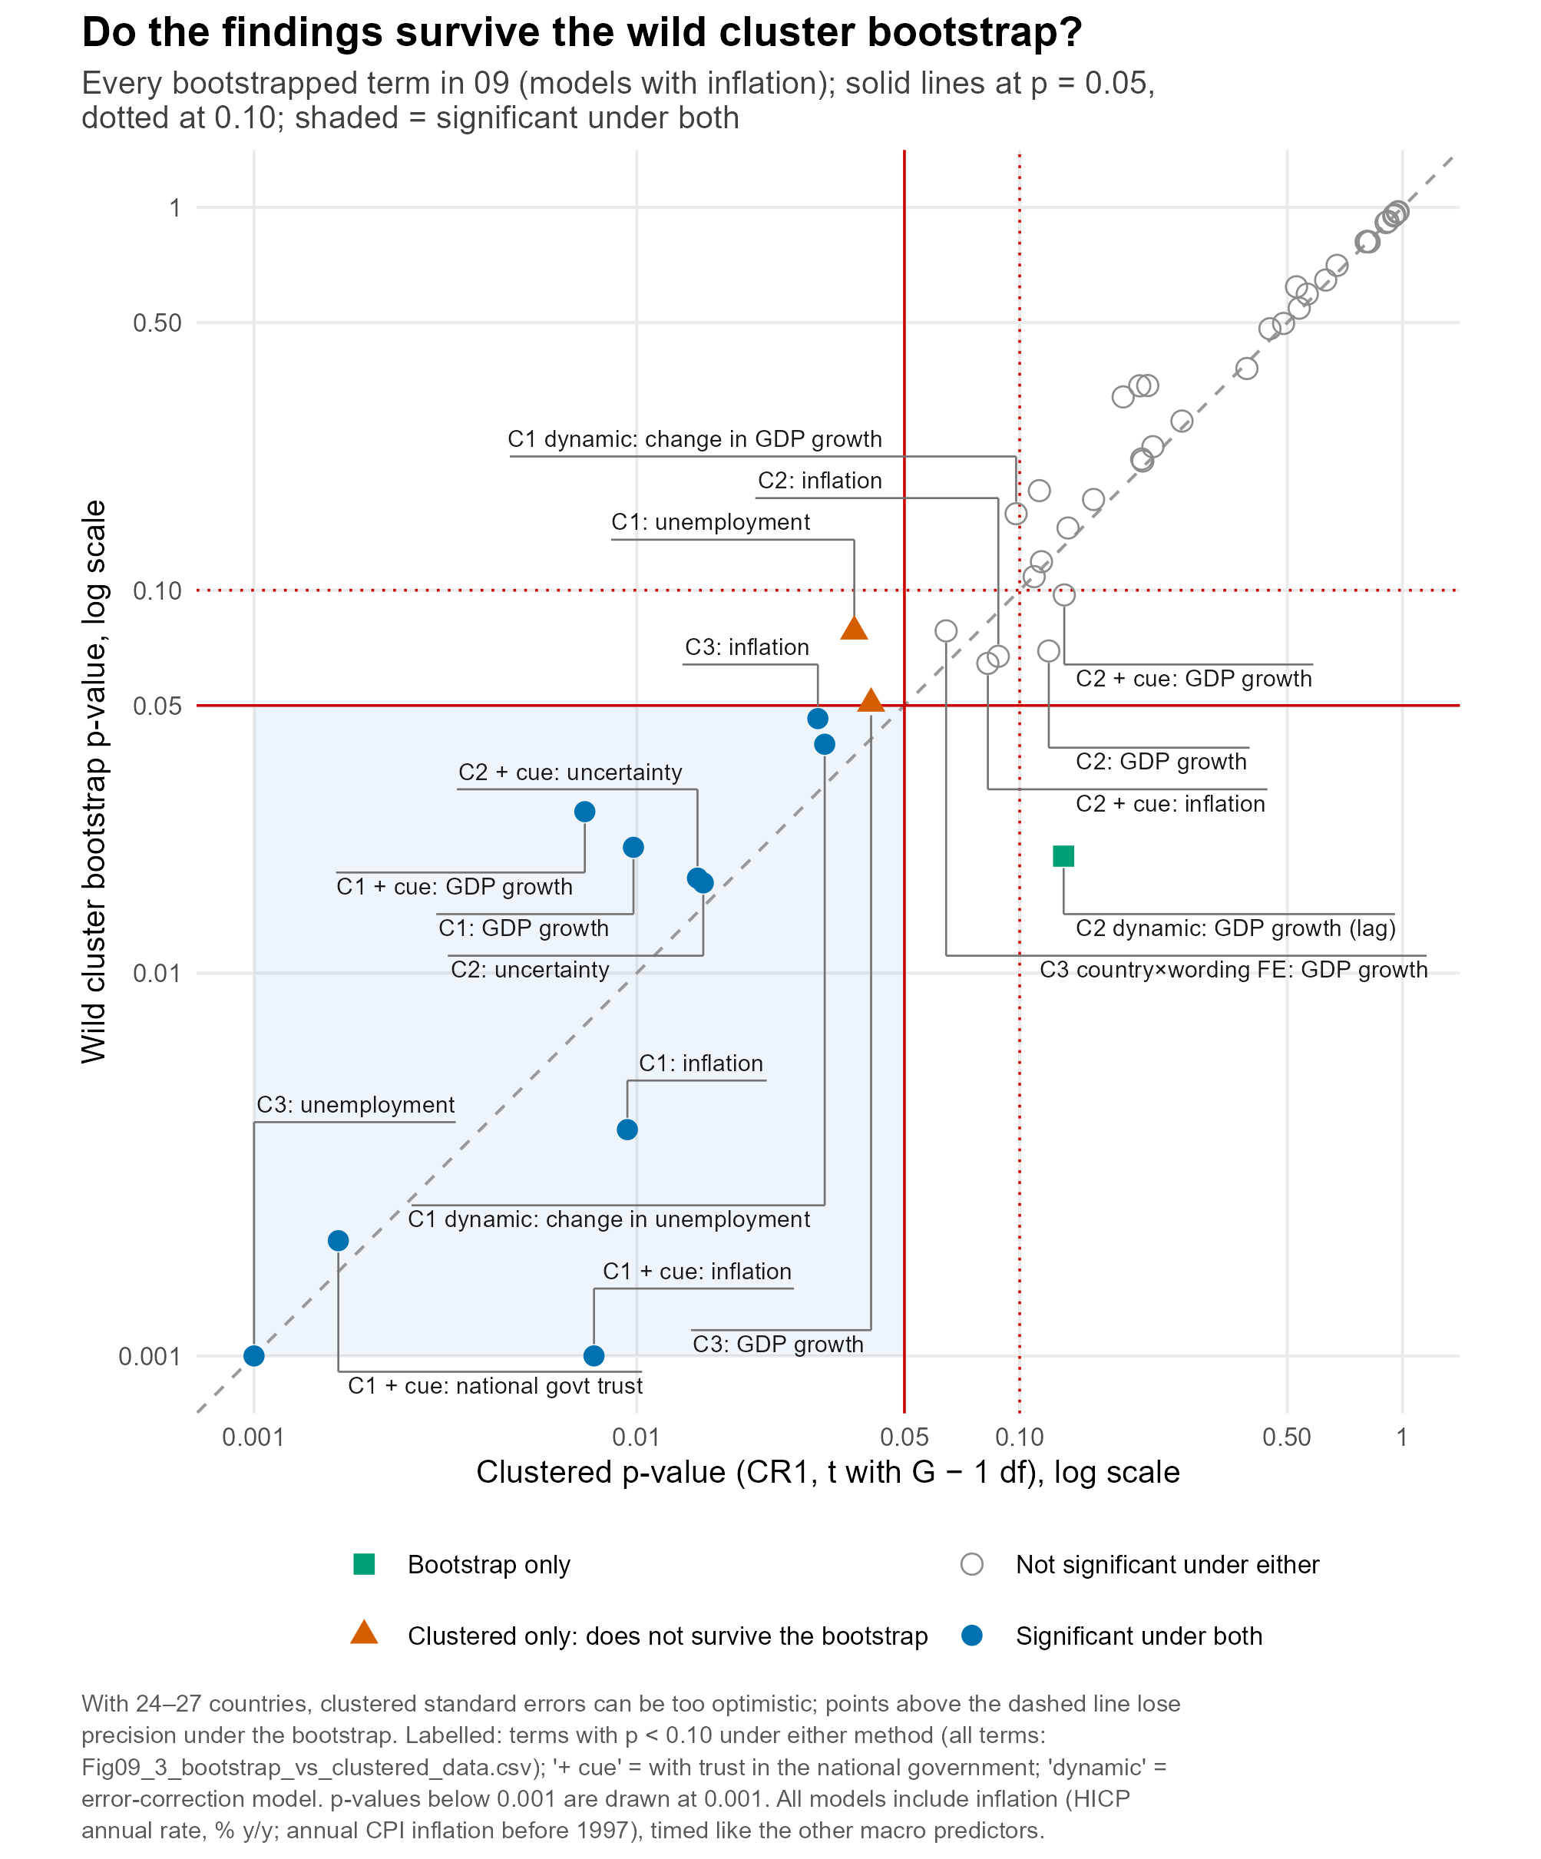

Slide 29
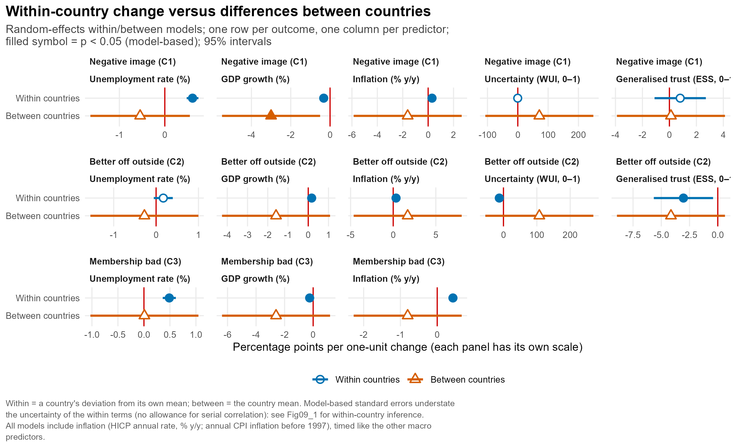

Slide 30
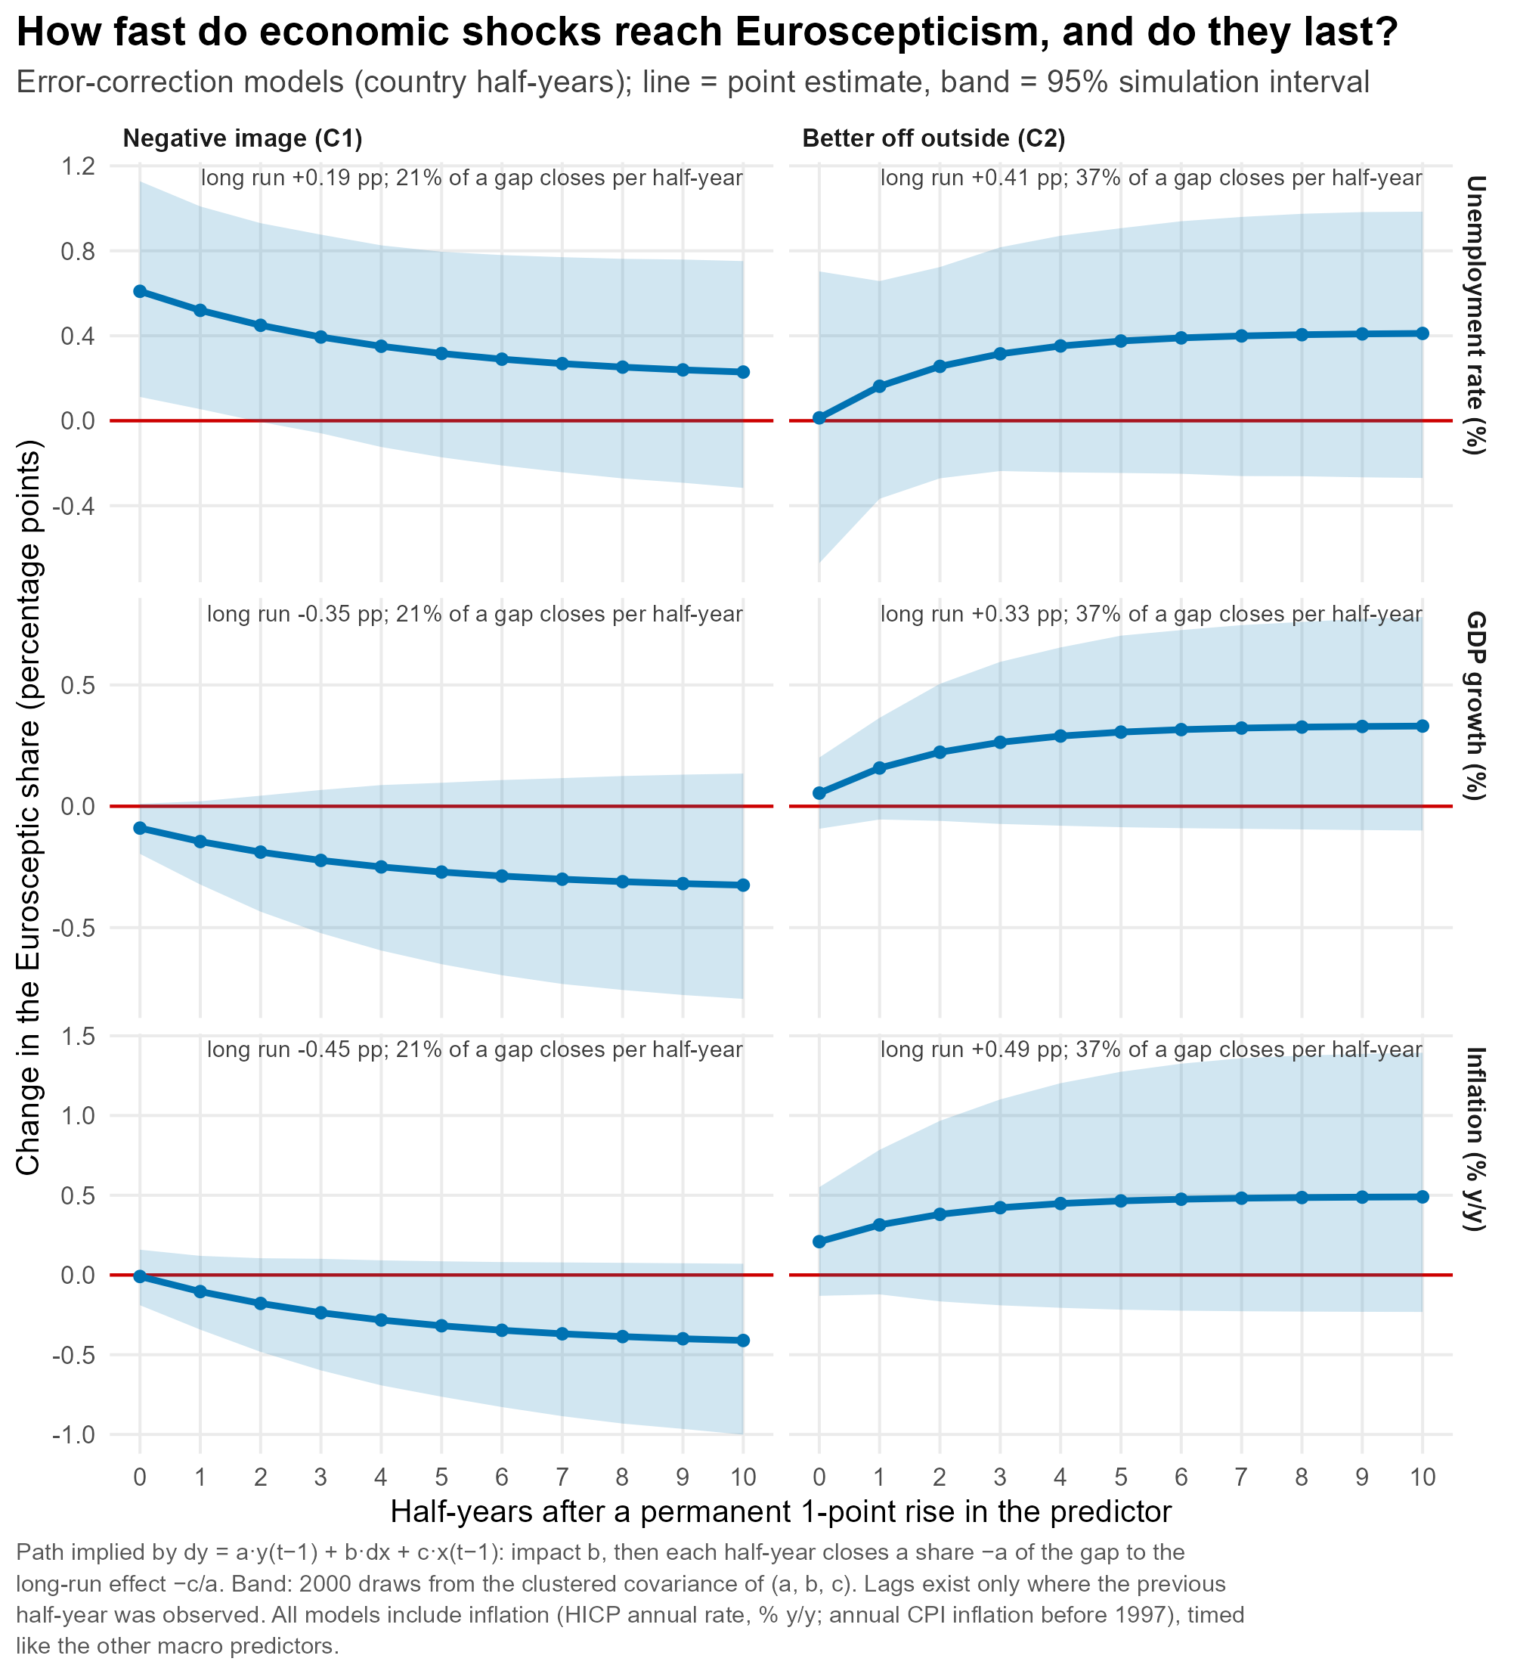

Slide 31
Conclusion

Slide 32
References
Adams, James, Luca Bernardi, and M. Christine Phillips. “The Simplest Government Heuristic of All: Citizens Infer That Governing Parties Are Pro-European Union.” Comparative Political Studies 54, no. 7 (2021): 1227–55.
Anderson, Christopher J. “When in Doubt, Use Proxies: Attitudes toward Domestic Politics and Support for European Integration.” Comparative Political Studies 31, no. 5 (1998): 569–601.
Bischof, Daniel, and Markus Wagner. “Do Voters Polarize When Radical Parties Enter Parliament?” American Journal of Political Science 63, no. 4 (2019): 888–904.
Bol, Damien, Marco Giani, André Blais, and Peter John Loewen. “The Effect of COVID-19 Lockdowns on Political Support: Some Good News for Democracy?” European Journal of Political Research 60 (2021): 497–505.
Braun, Daniela, Sebastian Adrian Popa, and Hermann Schmitt. “Responding to the Crisis: Eurosceptic Parties of the Left and Right and Their Changing Position towards the European Union.” European Journal of Political Research 58, no. 3 (2019): 797–819.
Clarke, Harold D., Matthew Goodwin, and Paul Whiteley. “Why Britain Voted for Brexit: An Individual-Level Analysis of the 2016 Referendum Vote.” Parliamentary Affairs 70, no. 3 (2017): 439–64.
Czymara, Christian S., and Alexander W. Schmidt-Catran. “Refugees Unwelcome? Changes in the Public Acceptance of Immigrants and Refugees in Germany in the Course of Europe’s ‘Immigration Crisis.’” European Sociological Review 33, no. 6 (2017): 735–51.
Dalton, Russell J. “National/European Identities and Political Alignments.” European Union Politics 22, no. 2 (2021): 340–50.
Davidov, Eldad, Bart Meuleman, Jan Cieciuch, Peter Schmidt, and Jaak Billiet. “Measurement Equivalence in Cross-National Research.” Annual Review of Sociology 40 (2014): 55–75.
De Vries, Catherine E., and Erica E. Edwards. “Taking Europe to Its Extremes: Extremist Parties and Public Euroscepticism.” Party Politics 15, no. 1 (2009): 5–28.

Slide 33
References
Delhey, Jan, and Kenneth Newton. “Predicting Cross-National Levels of Social Trust: Global Pattern or Nordic Exceptionalism?” European Sociological Review 21, no. 4 (2005): 311–27.
Dennison, James, Eldad Davidov, and Daniel Seddig. “Explaining Voting in the UK’s 2016 EU Referendum: Values, Attitudes to Immigration, European Identity and Political Trust.” Social Science Research 92 (2020): 102476.
Devine, Daniel, Jennifer Gaskell, Will Jennings, and Gerry Stoker. “Trust and the Coronavirus Pandemic: What Are the Consequences of and for Trust? An Early Review of the Literature.” Political Studies Review 19, no. 2 (2021): 274–85.
Dijkstra, Lewis, Hugo Poelman, and Andrés Rodríguez-Pose. “The Geography of EU Discontent.” Regional Studies 54, no. 6 (2020): 737–53.
Dotti Sani, Giulia M., and Beatrice Magistro. “Increasingly Unequal? The Economic Crisis, Social Inequalities and Trust in the European Parliament in 20 European Countries.” European Journal of Political Research 55, no. 2 (2016): 246–64.
Eichenberg, Richard C., and Russell J. Dalton. “Post-Maastricht Blues: The Transformation of Citizen Support for European Integration, 1973–2004.” Acta Politica 42 (2007): 128–52.
Follesdal, Andreas, and Simon Hix. “Why There Is a Democratic Deficit in the EU: A Response to Majone and Moravcsik.” Journal of Common Market Studies 44, no. 3 (2006): 533–62.
Foster, Chase, and Jeffry Frieden. “Economic Determinants of Public Support for European Integration, 1995–2018.” European Union Politics, OnlineFirst version (2021).
Gidron, Noam, and Peter A. Hall. “The Politics of Social Status: Economic and Cultural Roots of the Populist Right.” British Journal of Sociology 68, no. S1 (2017): S57–S84.
Guiso, Luigi, Helios Herrera, Massimo Morelli, and Tommaso Sonno. “Economic Insecurity and the Demand for Populism in Europe.” Economica 91, no. 362 (2024): 588–620.

Slide 34
References
Gustavsson, Gina, and Ludvig Stendahl. “National Identity, a Blessing or a Curse? The Divergent Links from National Attachment, Pride, and Chauvinism to Social and Political Trust.” European Political Science Review 12 (2020): 449–68.
Hakhverdian, Armen, Erika van Elsas, Wouter van der Brug, and Theresa Kuhn. “Euroscepticism and Education: A Longitudinal Study of 12 EU Member States, 1973–2010.” European Union Politics 14, no. 4 (2013): 522–41.
Hobolt, Sara B., and Catherine E. de Vries. “Issue Entrepreneurship and Multiparty Competition.” Comparative Political Studies 48, no. 9 (2015): 1159–85.
Hobolt, Sara B., and Catherine E. de Vries. “Public Support for European Integration.” Annual Review of Political Science 19 (2016): 413–32.
Hobolt, Sara B., Thomas J. Leeper, and James Tilley. “Divided by the Vote: Affective Polarization in the Wake of the Brexit Referendum.” British Journal of Political Science 51 (2021): 1476–93.
Hooghe, Liesbet, and Gary Marks. “Calculation, Community and Cues: Public Opinion on European Integration.” European Union Politics 6, no. 4 (2005): 419–43.
Hooghe, Liesbet, and Gary Marks. “A Postfunctionalist Theory of European Integration: From Permissive Consensus to Constraining Dissensus.” British Journal of Political Science 39 (2009): 1–23.
Hooghe, Liesbet, and Gary Marks. “Cleavage Theory Meets Europe’s Crises: Lipset, Rokkan, and the Transnational Cleavage.” Journal of European Public Policy 25, no. 1 (2018): 109–35.
Inglehart, Ronald, and Pippa Norris. “Trump and the Populist Authoritarian Parties: The Silent Revolution in Reverse.” Perspectives on Politics 15, no. 2 (2017): 443–54.
Inglehart, Ronald F., and Pippa Norris. “Trump, Brexit, and the Rise of Populism: Economic Have-Nots and Cultural Backlash.” Faculty Research Working Paper Series RWP16-026. Cambridge, MA: Harvard Kennedy School, 2016.

Slide 35
References
Jolly, Seth, Ryan Bakker, Liesbet Hooghe, Gary Marks, Jonathan Polk, Jan Rovny, Marco Steenbergen, and Milada Anna Vachudova. “Chapel Hill Expert Survey Trend File, 1999–2019.” Electoral Studies 75 (2022): 102420.
Jurado, Kyle, Sydney C. Ludvigson, and Serena Ng. “Measuring Uncertainty.” NBER Working Paper 19456. Cambridge, MA: National Bureau of Economic Research, 2013.
Kang, Yoo-Duk, and Chang-Rhyong Oh. “Spreading Euroscepticism and Its Macro-level Determinants: Empirical Analysis of Eurobarometer Survey in 2004–2017.” Journal of Contemporary European Studies 28, no. 3 (2020): 348–65.
Katsanidou, Alexia, and Quinton Mayne. “Is There a Geography of Euroscepticism among the Winners and Losers of Globalization?” Journal of European Public Policy 31, no. 6 (2024): 1693–718.
Kelemen, R. Daniel, and Kathleen R. McNamara. “State-Building and the European Union: Markets, War, and Europe's Uneven Political Development.” Comparative Political Studies 55, no. 6 (2022): 963–91.
Kentmen-Cin, Cigdem, and Cengiz Erisen. “Anti-immigration Attitudes and the Opposition to European Integration: A Critical Assessment.” European Union Politics 18, no. 1 (2017): 3–25
Kriesi, Hanspeter. “The Role of European Integration in National Election Campaigns.” European Union Politics 8, no. 1 (2007): 83–108.
Kriesi, Hanspeter. “Restructuration of Partisan Politics and the Emergence of a New Cleavage Based on Values.” West European Politics 33, no. 3 (2010): 673–85.
Kriesi, Hanspeter. “The Politicization of European Integration.” Journal of Common Market Studies 54, no. S1 (2016): 32–47.
Kritzinger, Sylvia, Martial Foucault, Romain Lachat, Julia Partheymüller, Carolina Plescia, and Sylvain Brouard. “‘Rally Round the Flag’: The COVID-19 Crisis and Trust in the National Government.” West European Politics 44, no. 5–6 (2021): 1205–31.
Kuhn, Theresa, Erika van Elsas, Armen Hakhverdian, and Wouter van der Brug. “An Ever Wider Gap in an Ever Closer Union: Rising Inequalities and Euroscepticism in 12 West European Democracies, 1975–2009.” Socio-Economic Review 14, no. 1 (2016): 27–45.

Slide 36
References
Kumlin, Staffan, and Bo Rothstein. “Making and Breaking Social Capital: The Impact of Welfare-State Institutions.” Comparative Political Studies 38, no. 4 (2005): 339–65.
Kuntz, Anabel, Eldad Davidov, and Moshe Semyonov. “The Dynamic Relations between Economic Conditions and Anti-immigrant Sentiment: A Natural Experiment in Times of the European Economic Crisis.” International Journal of Comparative Sociology 58, no. 5 (2017): 392–415.
Kurer, Thomas. “The Declining Middle: Occupational Change, Social Status, and the Populist Right.” Comparative Political Studies 53, no. 10–11 (2020): 1798–835.
Larsen, Erik Gahner, David Cutts, and Matthew J. Goodwin. “Do Terrorist Attacks Feed Populist Eurosceptics? Evidence from Two Comparative Quasi-Experiments.” European Journal of Political Research 59, no. 1 (2020): 182–205.
Legewie, Joscha. “Terrorist Events and Attitudes toward Immigrants: A Natural Experiment.” American Journal of Sociology 118, no. 5 (2013): 1199–245.
Leitgöb, Heinz, Daniel Seddig, Tihomir Asparouhov, Dorothée Behr, Eldad Davidov, Kim De Roover, Suzanne Jak, et al. “Measurement Invariance in the Social Sciences: Historical Development, Methodological Challenges, State of the Art, and Future Perspectives.” Social Science Research 110 (2023): 102805.
Lerner, Jennifer S., and Dacher Keltner. “Beyond Valence: Toward a Model of Emotion-Specific Influences on Judgement and Choice.” Cognition and Emotion 14, no. 4 (2000): 473–93.
Lucassen, Geertje, and Marcel Lubbers. “Who Fears What? Explaining Far-Right-Wing Preference in Europe by Distinguishing Perceived Cultural and Economic Ethnic Threats.” Comparative Political Studies 45, no. 5 (2012): 547–74.
Mair, Peter. “Political Opposition and the European Union.” Government and Opposition 42, no. 1 (2007): 1–17.
Malet, Giorgio, and Sven Hegewald. “The Changing Geography of Support for European Integration in the Shadow of the Ukraine War.” Journal of European Public Policy, published ahead of print, October 18, 2025.
Marks, Gary, and Liesbet Hooghe. “National Identity and Support for European Integration.” WZB Discussion Paper SP IV 2003-202. Berlin: Wissenschaftszentrum Berlin für Sozialforschung, 2003.

Slide 37
References
Mauerer, Ingrid, M. Socorro Puy, and Sergi Urzay-Gómez. “Explaining Preferences for EU Integration: Theory and Empirical Evidence.” European Economic Review 176 (2025): 105038.
Mayne, Quinton, and Alexia Katsanidou. “Subnational Economic Conditions and the Changing Geography of Mass Euroscepticism: A Longitudinal Analysis.” European Journal of Political Research 62, no. 3 (2023): 742–60.
McLaren, Lauren M. “Public Support for the European Union: Cost/Benefit Analysis or Perceived Cultural Threat?” Journal of Politics 64, no. 2 (2002): 551–66.
McLaren, Lauren M. “The Cultural Divide in Europe: Migration, Multiculturalism, and Political Trust.” World Politics 64, no. 2 (2012): 199–241.
Meuleman, Bart, Eldad Davidov, and Jaak Billiet. “Changing Attitudes toward Immigration in Europe, 2002–2007: A Dynamic Group Conflict Theory Approach.” Social Science Research 38 (2009): 352–65.
Muñoz, Jordi, Albert Falcó-Gimeno, and Enrique Hernández. “Unexpected Event during Survey Design: Promise and Pitfalls for Causal Inference.” Political Analysis 28, no. 2 (2020): 186–206.
Negri, Fedra, Francesco Nicoli, and Theresa Kuhn. “Common Currency, Common Identity? The Impact of the Euro Introduction on European Identity.” Authors’ preprint, 2020 (published in European Union Politics 22, no. 1 [2021]: 114–32).
Nicoli, Francesco, and Ann-Kathrin Reinl. “A Tale of Two Crises? A Regional-Level Investigation of the Joint Effect of Economic Performance and Migration on the Voting for European Disintegration.” Comparative European Politics 18 (2020): 384–419.
Palacios, Irene, and Christine Arnold. “The Divided Public: Dynamics of Heterogeneity of European Public Opinion towards European Integration.” European Union Politics 25, no. 4 (2024): 698–722.
Quillian, Lincoln. “Prejudice as a Response to Perceived Group Threat: Population Composition and Anti-Immigrant and Racial Prejudice in Europe.” American Sociological Review 60, no. 4 (1995): 586–611.

Slide 38
References
Reinl, Ann-Kathrin, Francesco Nicoli, and Theresa Kuhn. “Regional Inequalities and Transnational Solidarity in the European Union.” Political Geography 104 (2023): 102903.
Rothstein, Bo, and Eric M. Uslaner. “All for All: Equality, Corruption, and Social Trust.” World Politics 58, no. 1 (2005): 41–72.
Scheepers, Peer, Mérove Gijsberts, and Marcel Coenders. “Ethnic Exclusionism in European Countries: Public Opposition to Civil Rights for Legal Migrants as a Response to Perceived Ethnic Threat.” European Sociological Review 18, no. 1 (2002): 17–34.
Schraff, Dominik. “Political Trust during the Covid-19 Pandemic: Rally around the Flag or Lockdown Effects?” European Journal of Political Research 60, no. 4 (2021): 1007–17.
Semyonov, Moshe, Rebeca Raijman, and Anastasia Gorodzeisky. “The Rise of Anti-foreigner Sentiment in European Societies, 1988–2000.” American Sociological Review 71, no. 3 (2006): 426–49.
Serricchio, Fabio, Myrto Tsakatika, and Lucia Quaglia. “Euroscepticism and the Global Financial Crisis.” Journal of Common Market Studies 51, no. 1 (2013): 51–64.
Steenvoorden, Eefje, and Eelco Harteveld. “The Appeal of Nostalgia: The Influence of Societal Pessimism on Support for Populist Radical Right Parties.” West European Politics 41, no. 1 (2018): 28–52.
Stoeckel, Florian. “Ambivalent or Indifferent? Reconsidering the Structure of EU Public Opinion.” Author’s manuscript (published in European Union Politics 14, no. 1 [2013]: 23–45).
Sønderskov, Kim Mannemar, and Peter Thisted Dinesen. “Trusting the State, Trusting Each Other? The Effect of Institutional Trust on Social Trust.” Political Behavior 38 (2016): 179–202.
Taggart, Paul, and Aleks Szczerbiak. “Putting Brexit into Perspective: The Effect of the Eurozone and Migration Crises and Brexit on Euroscepticism in European States.” Journal of European Public Policy 25, no. 8 (2018): 1194–214.
Toshkov, Dimiter, and André Krouwel. “Beyond the U-Curve: Citizen Preferences on European Integration in Multidimensional Political Space.” European Union Politics 23, no. 3 (2022): 462–88.

Slide 39
References
van der Meer, Tom, and Armen Hakhverdian. “Political Trust as the Evaluation of Process and Performance: A Cross-National Study of 42 European Countries.” Political Studies 65, no. 1 (2017): 81–102.
Vasilopoulos, Pavlos, George E. Marcus, Nicholas A. Valentino, and Martial Foucault. “Fear, Anger, and Voting for the Far Right: Evidence from the November 13, 2015 Paris Terror Attacks.” Political Psychology 40, no. 4 (2019): 679–704.
Vasilopoulou, Sofia. “Theory, Concepts and Research Design in the Study of Euroscepticism.” In The Routledge Handbook of Euroscepticism, edited by Benjamin Leruth, Nicholas Startin, and Simon Usherwood, 22–35. London: Routledge, 2017.
Vasilopoulou, Sofia, and Liisa Talving. “Poor versus Rich Countries: A Gap in Public Attitudes towards Fiscal Solidarity in the EU.” West European Politics 43, no. 4 (2020): 919–43.
Vasilopoulou, Sofia, and Liisa Talving. “Euroscepticism as a Syndrome of Stagnation? Regional Inequality and Trust in the EU.” Journal of European Public Policy 31, no. 6 (2024): 1494–515.
Vergioglou, Ioannis, and Sven Hegewald. “From Causes to Consequences: Investigating the Effects of Differentiated Integration on Citizens’ EU Support.” European Union Politics 24, no. 1 (2023): 206–24.
Zmerli, Sonja, and Ken Newton. “Social Trust and Attitudes toward Democracy.” Public Opinion Quarterly 72, no. 4 (2008): 706–24.

